Slide 1
Introduction to Deep Learning in TF 2.0
Usha Rengaraju

Slide 2
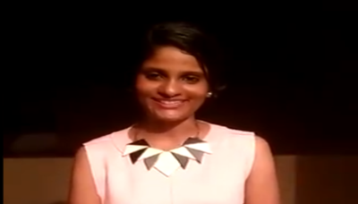
About Me
Kaggle Grandmaster
WiMLDS(Bangalore and Mysore)
TensorFlow User Group Organizer Mysuru
GDG Mysore Organizer Mysuru
Twitter : @URengaraju
Github : https://github.com/ushareng
Ambassador : Women TechMakers Mysuru , WiDS Mysuru(Women in Data Science)

Slide 3
Communities
WiMLDS Mysore :
https://www.meetup.com/Mysore-Women-in-Machine-Learning-and-Data-Science/
GDG Mysuru :
https://www.meetup.com/Google-Developers-group-Mysuru/
TensorFlow User Group Mysuru :
https://www.meetup.com/TFUG-Mysuru/

Slide 4
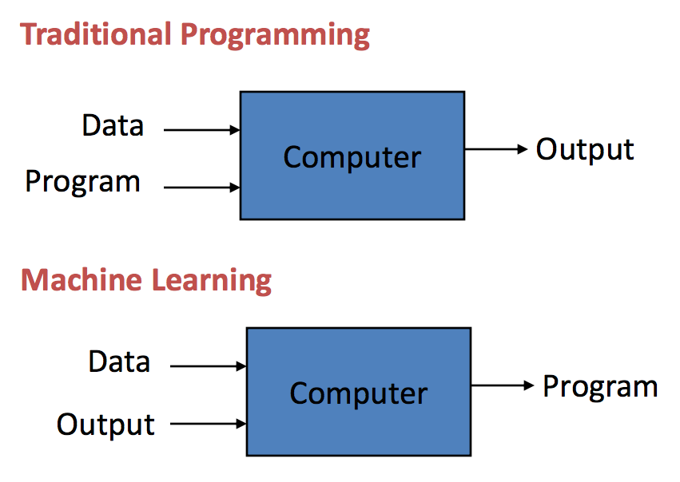
Machine Learning
“Machine Learning is the science of getting computers to act without being explicitly programmed “ - Andrew NG
Notes:
Pic Credit : https://machinelearningmastery.com/basic-concepts-in-machine-learning/

Slide 5
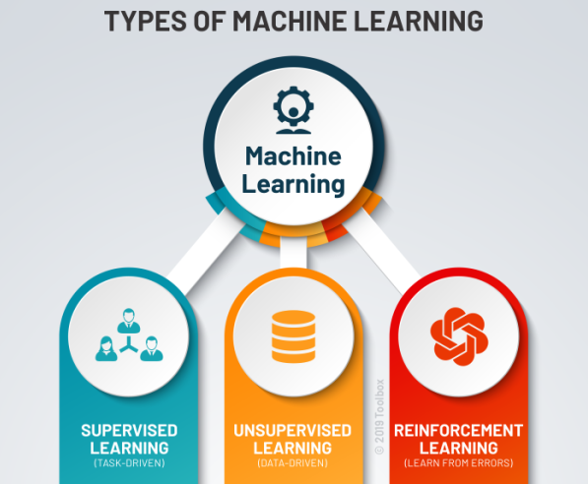
Types of Machine Learning
.
Notes:
Pic Credit : https://www.potentiaco.com/what-is-machine-learning-definition-types-applications-and-examples/

Slide 6
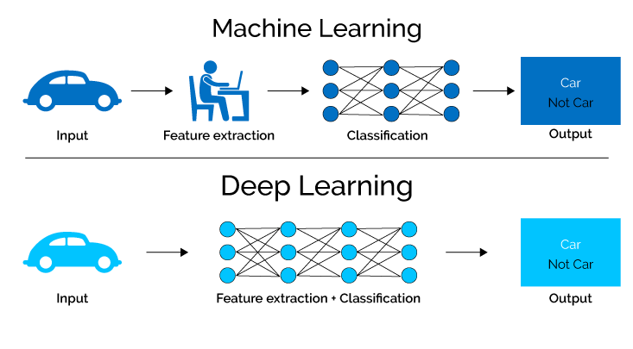
Deep Learning
Deep learning methods aim at learning feature hierarchies with features from higher levels of the hierarchy formed by the composition of lower level features. Automatically learning features at multiple levels of abstraction allow a system to learn complex functions mapping the input to the output directly from data, without depending completely on human-crafted features.-- “Learning Deep Architectures of AI”
Notes:
Pic Credit : https://semiengineering.com/deep-learning-spreads/
https://machinelearningmastery.com/what-is-deep-learning/

Slide 7
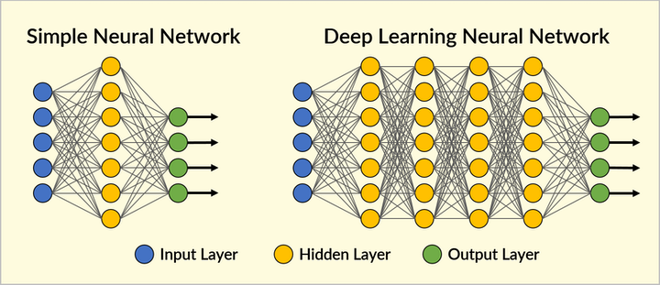
Neural Network Structure
..
Notes:
Pic Credit : https://www.securityinfowatch.com/video-surveillance/video-analytics/article/21069937/deep-learning-to-the-rescue

Slide 8
Important Concepts
Optimizer
Loss
Metrics
Activation Functions

Slide 9
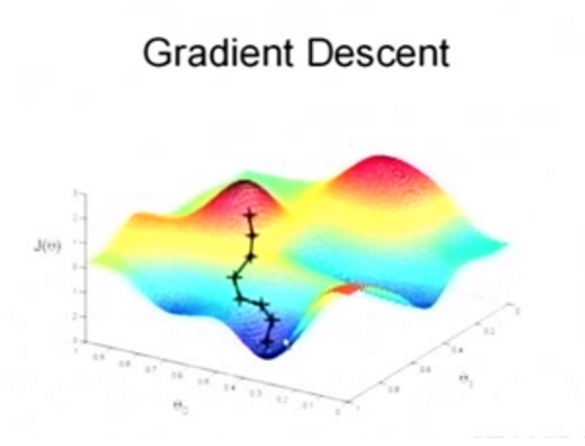
Optimizer
Optimizer minimizes Cost Function
Notes:
Pic Credit : https://www.quora.com/What-is-an-intuitive-explanation-of-the-AdaDelta-Deep-Learning-optimizer

Slide 10
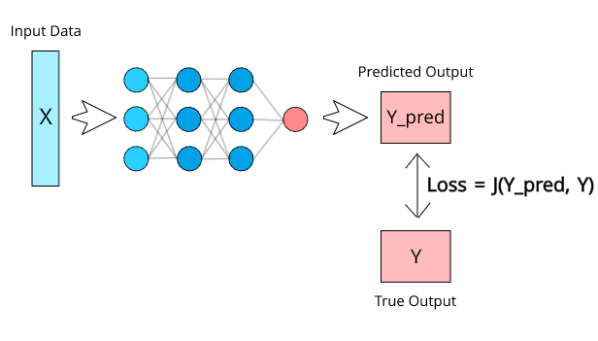
Loss
.
Notes:
Pic Credit : https://zhuanlan.zhihu.com/p/85540935

Slide 11
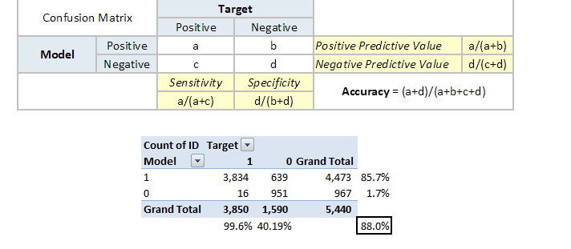
Metrics
.
Notes:
Pic Credit : https://www.analyticsvidhya.com/blog/2019/08/11-important-model-evaluation-error-metrics/

Slide 12
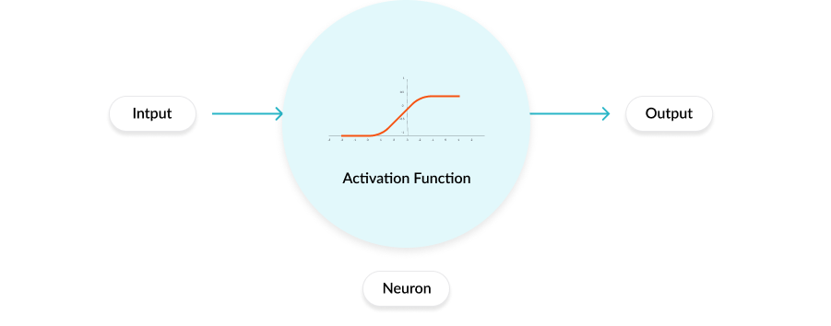
Activation Functions
Notes:
Pic Credit : https://missinglink.ai/guides/neural-network-concepts/7-types-neural-network-activation-functions-right/

Slide 13
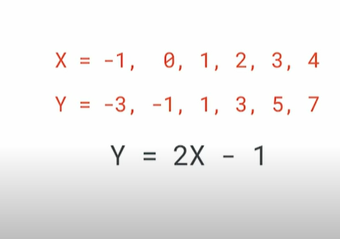
Hello World of ML in TF 2.0
.
Notes:
Pic Credit : TensorFlow Youtube Channel

Slide 14
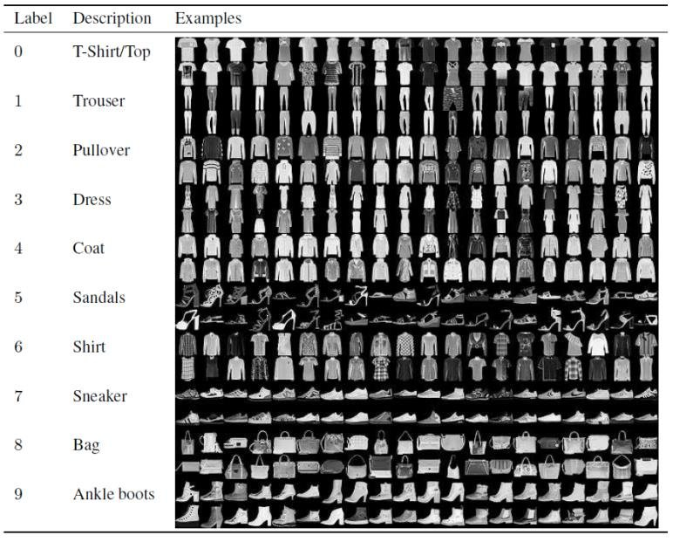
Fashion MNIST
.
Notes:
Pic Credit : https://www.researchgate.net/figure/Fashion-MNIST-Dataset-Images-with-Labels-and-Description-II-LITERATURE-REVIEW-In-image_fig1_340299295

Slide 15
Colab Notebook Links
Hello World !!
https://colab.research.google.com/drive/10U7mYzUkYfVKf3T_Fo7uUxuGhCUcXW66?usp=sharing
Fashion MNIST
https://colab.research.google.com/drive/1kTICATcD28oB_8cswagnpOPr_YppFquC?usp=sharing

Slide 16
Thank You

